Slide 1
Natural Language Processing
Mini Project
Text Summarization of News Reports
Team - 22
Anant Vaid
R Harish
Tejeshwar U

Slide 2
Paper Reviews

Slide 3
Abstractive Text Summarization using Sequence to Sequence RNNs and Beyond
The Baseline model was Bidirectional GRU encoder and Unidirectional GRU decoder with attention mechanism along with LVT.
Objective
Abstractive Summarization using attention based encoder-decoder RNNs.
Main Contributions
Modelling Keywords
Explicitly Capturing syntactic hierarchies.
Decoder able to emit rare/unseen words.
State of the Art Performance (2016)
Creating and Benchmarking dataset for multi-sentence summary summarization.

Slide 4
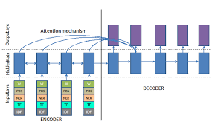
Modelling Keywords

Slide 5
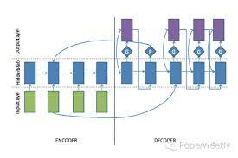
Decoder able to emit rare/unseen words

Slide 6
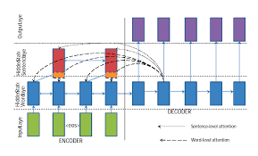
Explicitly capturing syntactic hierarchies

Slide 7
Neural Machine Translation by Jointly Learning to Align and Translate
The Baseline model was RNN Encoder-Decoder.
Objective
Being able to transform long sentences syntactically and semantically into target language.
Main Contributions
Novel Architecture for Neural Machine Translation.
Encoder - Bidirectional RNN
Decoder - extended with attention mechanism (Weighted sum of input hidden states.)
Learning to Align and Translate
The basic model was encoding whole input to a single-fixed length vector, but attention based model encodes input to a variable length sequence of vectors. While decoding, a subset of these vectors are chosen adaptively.

Slide 8
Neural Machine Translation by Jointly Learning to Align and Translate
The model checks the alignment of i^{th} word in the decoder with j word in the encoder and assigns alignment weights, which are further used as weights for hidden input states and thus used as an attention mechanism.
How does the model predict the target language?
Doesn’t attempt to encode whole input to a single fixed length vector. It encodes input into a sequence of vectors and chooses a subset of these adaptively during decoding translation.
Attention mechanism simply gives network access to its internal memory.
With this novel approach, information can be spread through a sequence which is selectively retrieved by the decoder.
The improvement was quite apparent over longer sentences, but it was observed with sentences of any length too.

Slide 9
Experimental Study of LSTM Encoder-Decoder Model for Text Simplification
BASE MODEL: RNN with LSTM cells
Objective
Simplify the text while retaining its Semantic Value
Main Contributions
Better simplification over the traditional methods such as Lexical and Rule based Simplification
LSTM Encoder- Decoder Framework
Input Embedding layer -> LSTM Encoding layer -> LSTM Decoder->Output Embedding Layer
How the model is expected to work
The model aims to convert sentences like -> Man with high intelligence -> A very smart man
This makes sentences more digestible and easier to understand

Slide 10
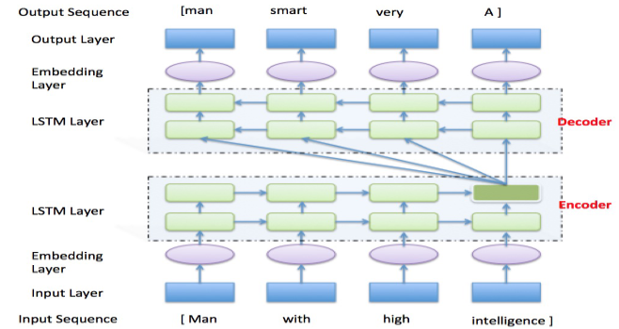
Experimental Study of LSTM Encoder-Decoder Model for Text Simplification
As we can see there is an embedding layer which uses one-hot encoding into atmost a 300-dimensional vector
Then 2 LSTM layers serve as encoder and decoder respectively
An output embedding layer and the output layer is present to give the text output

Slide 11
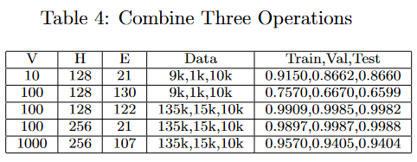
Experimental Study of LSTM Encoder-Decoder Model for Text Simplification
STRATEGY:
Simplifying a sentence is done by sorting,reversing and replacement
Replacement is similar to lexical simplification , sorting and reversing change the structure of the sentence.
For replacement only top 20% well known words were kept
Results indicated that the LSTM framework successfully learnt these rules

Slide 12
Deep Recurrent GRU Decoder for Abstractive Text Summarization
BASE MODEL: RNN with GRU cells using the VAE- Variational Auto Encoder technique
Objective
Able to summarize text better than the existing State of Art Architecture
Main Contributions
Novel improved framework for retaining context well for text summarization
GRU with VAE framework to closely model how humans do text summarization
Uses a variational encoder and a variational decoder for latent variable dependencies
Technique
To summarize on What Happened, Who Action What as humans summarize
This makes it more accurate for delivering text summaries

Slide 13
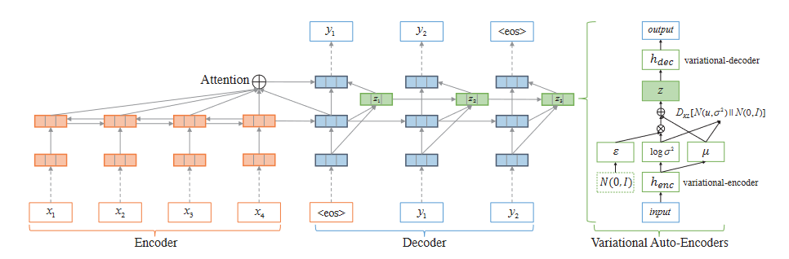
Deep Recurrent GRU Decoder for Abstractive Text Summarization

Slide 14
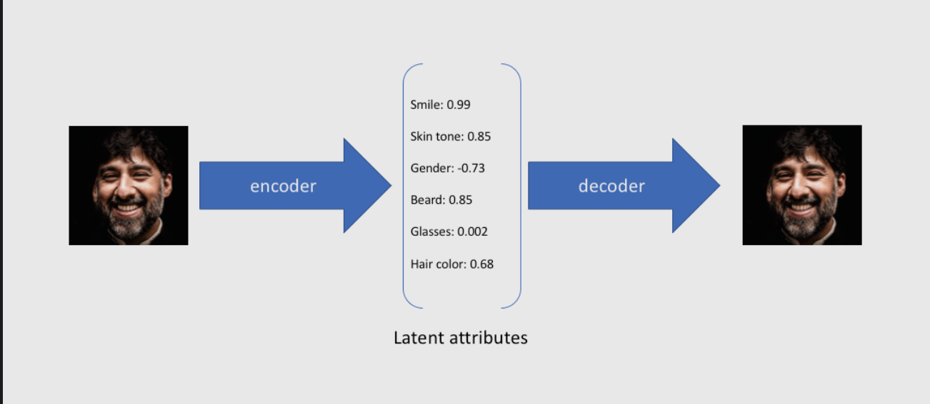
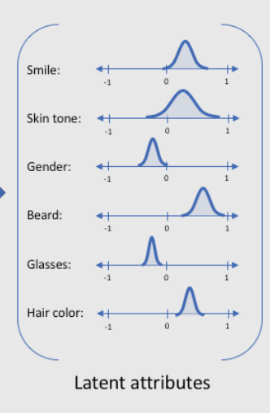
Deep Recurrent GRU Decoder for Abstractive Text Summarization

Slide 15
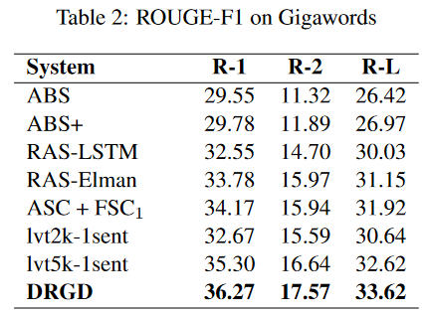
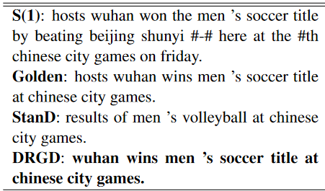
Deep Recurrent GRU Decoder for Abstractive Text Summarization
CONCLUSIONS:
Applying the GRU decoder with a VAE has shown boosts over the traditional architectures for text summarization
Used ROGUE score for evaluation, which shows how many n-grams matched with the actual o/p

Slide 16
Neural Abstractive Text Summarization with Sequence-to-Sequence Models
Objective
To provide comprehensive literature survey on different seq2seq models for abstractive text summarization from the viewpoint of network structures, training strategies, and summary generation algorithms.
Main Contributions
They have develop an open source library, namely, Neural Abstractive Text Summarizer (NATS) toolkit, for the abstractive text summarization which is equipped with several important features, including attention, pointing mechanism, repetition handling, and beam search.

Slide 17
Neural Abstractive Text Summarization with Sequence-to-Sequence Models
Most of these techniques differ in one of these three categories: network structure, parameter inference, and decoding/generation.
Problems Solved
P1: For the task of summarizing long documents into multi-sentence summaries, these models have several shortcomings: 1. They cannot accurately reproduce the salient information of source documents. 2. They cannot efficiently handle OOV words. 3. They tend to suffer from word- and sentence-level repetitions and generating unnatural summaries.
S1: pointer-generator architecture, pointing/copying mechanism, generator handles OOV words

Slide 18
Neural Abstractive Text Summarization with Sequence-to-Sequence Models
P2: While training exposure bias and mismatch of measurements.
S2: curriculum learning and reinforcement learning , MIXER (CL+RL), ROUGE and BLEU scores.
P3: Standard RNN models are difficult to train due to the vanishing and exploding gradients problems
S3: LSTM is a solution for vanishing gradients problem, exploding gradients issue is solved using a gradient norm clipping strategy
P4: Computation time and memory constraints of GPUs for LSTM's.
S4: CNN-based encoder decoder models have better performance. The model has short paths between pairs of input and output tokens, so that it can propagate gradient signals more efficiently

Slide 19
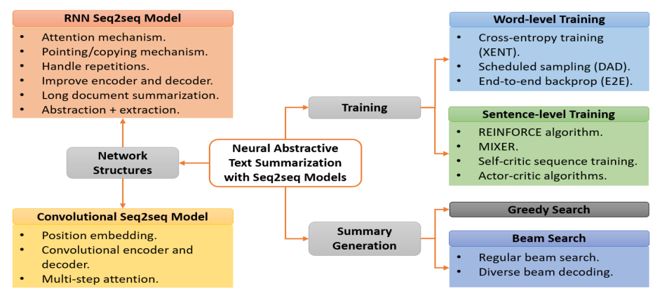
Neural Abstractive Text Summarization with Sequence-to-Sequence Models

Slide 20
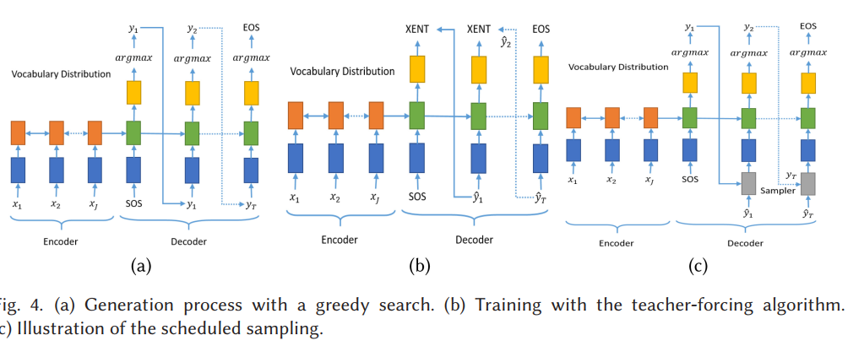
Neural Abstractive Text Summarization with Sequence-to-Sequence Models

Slide 21
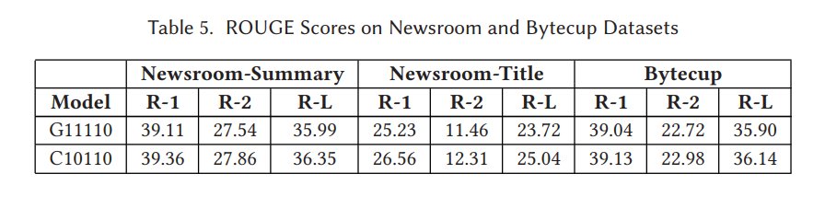
Neural Abstractive Text Summarization with Sequence-to-Sequence Models
Implementation

Slide 22
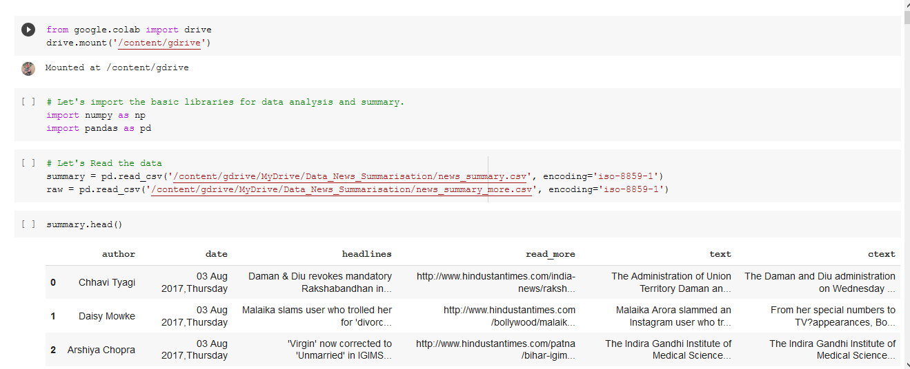
Code Implementation

Slide 23

Code Implementation

Slide 24
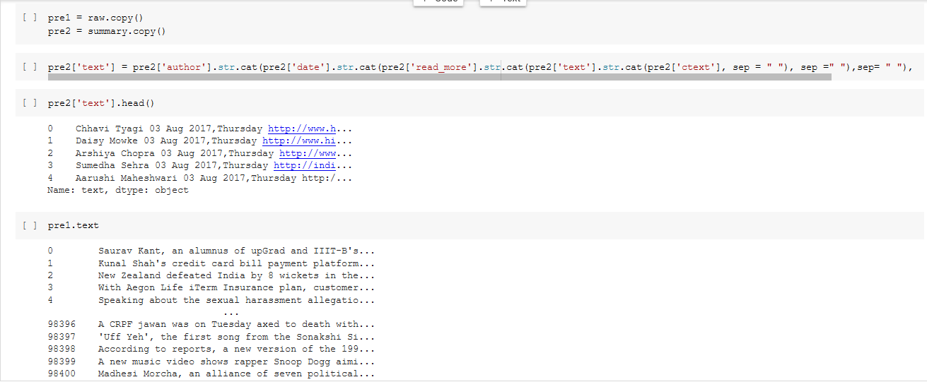
Code Implementation

Slide 25
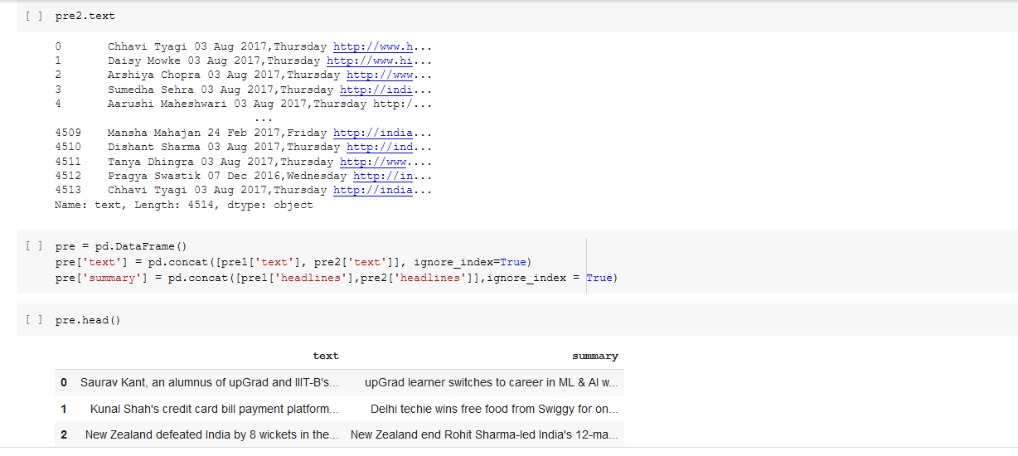
Code Implementation

Slide 26
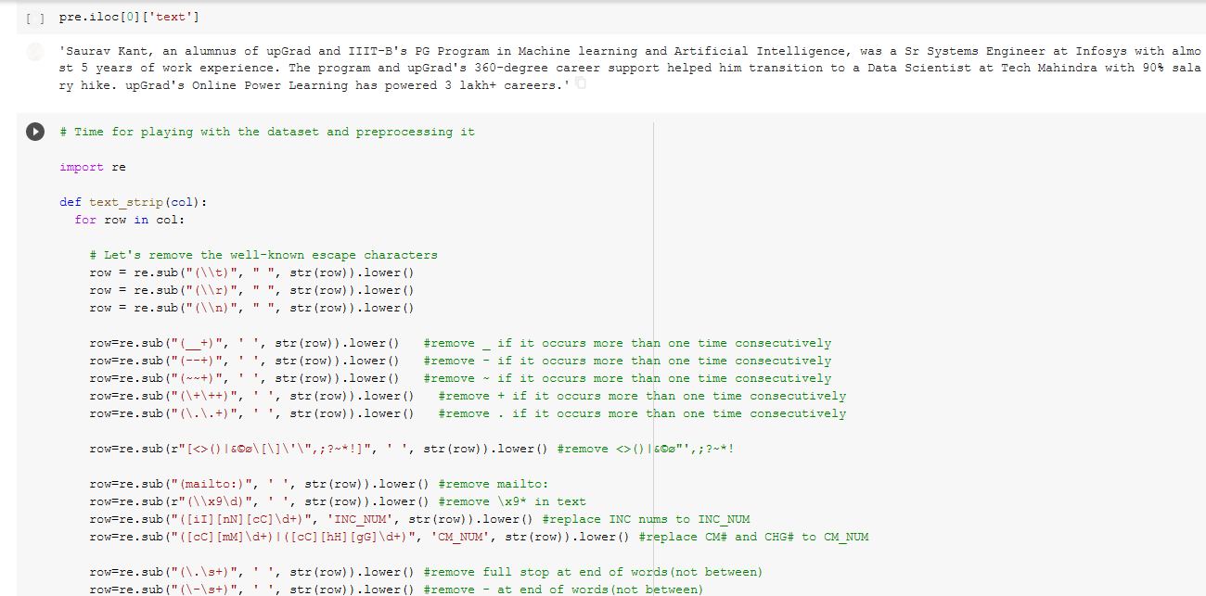
Code Implementation

Slide 27
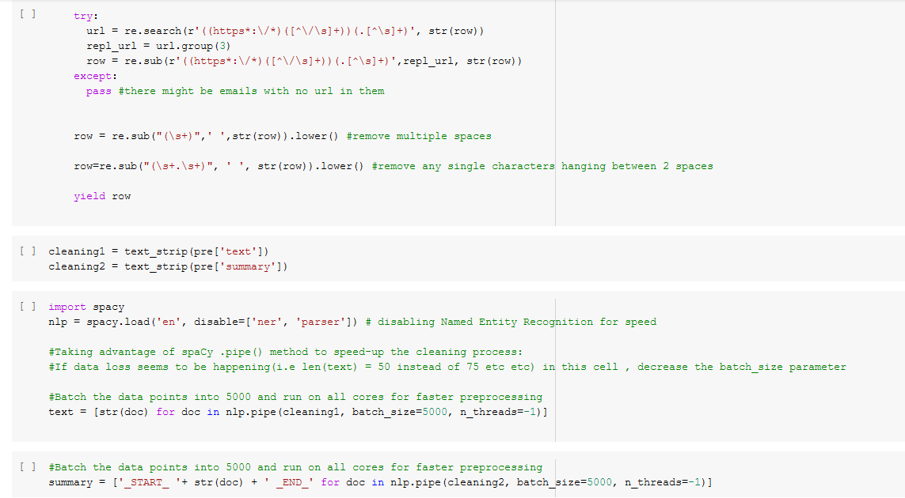
Code Implementation

Slide 28
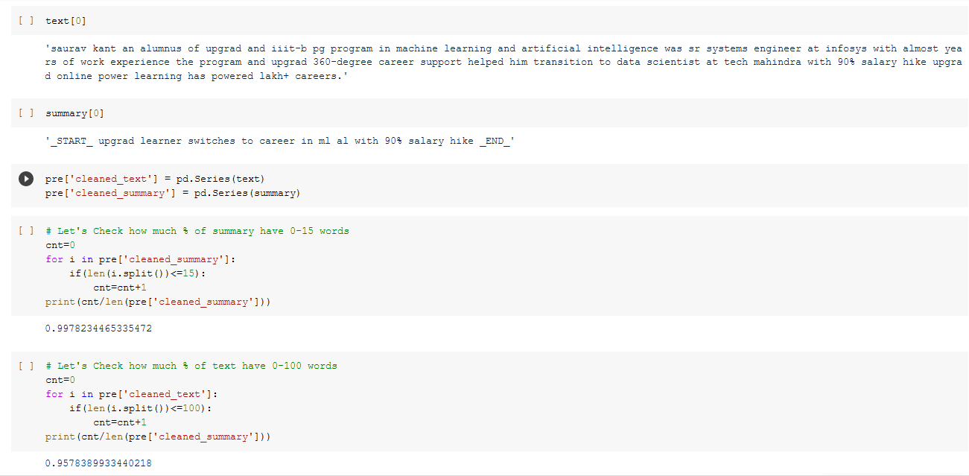
Code Implementation

Slide 29
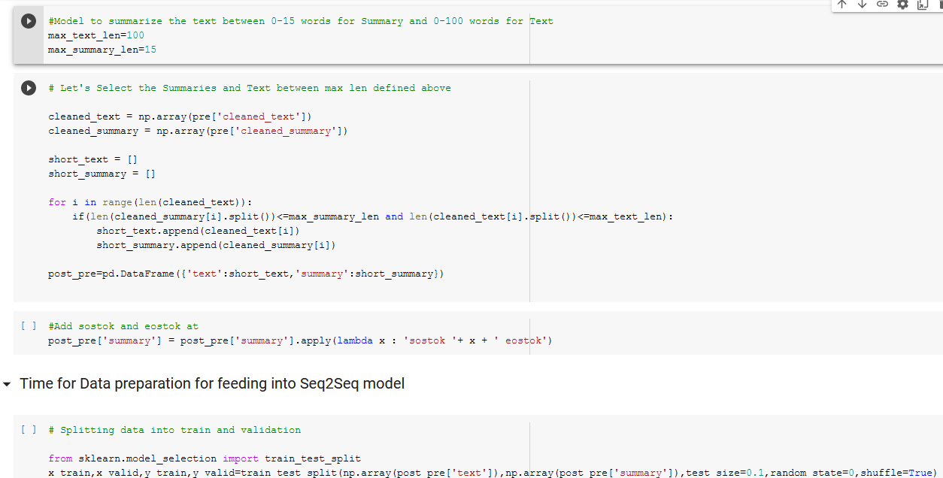
Code Implementation

Slide 30
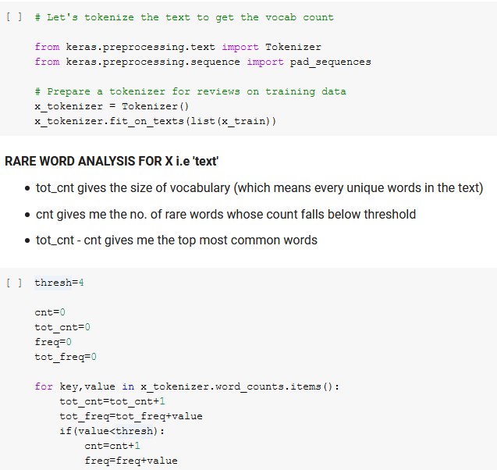
Code Implementation

Slide 31
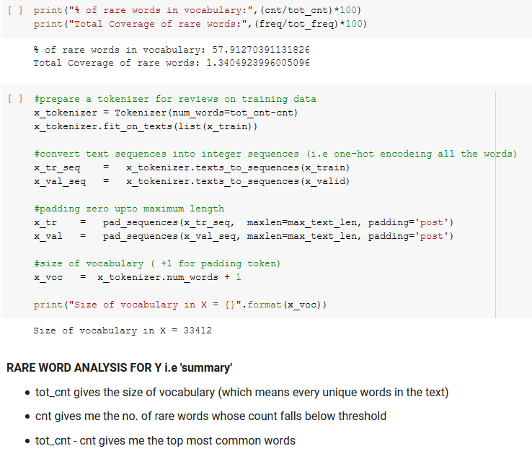
Code Implementation

Slide 32
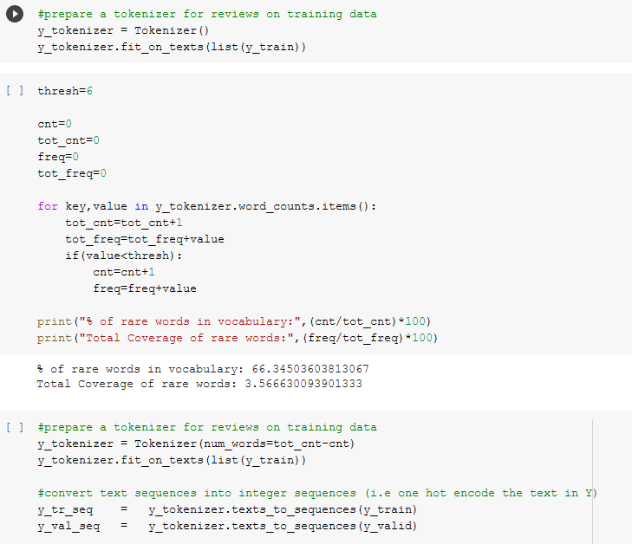
Code Implementation

Slide 33
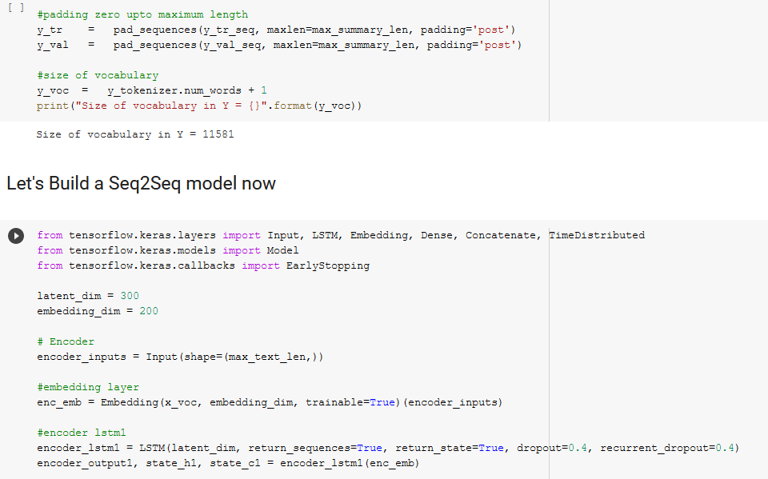
Code Implementation

Slide 34
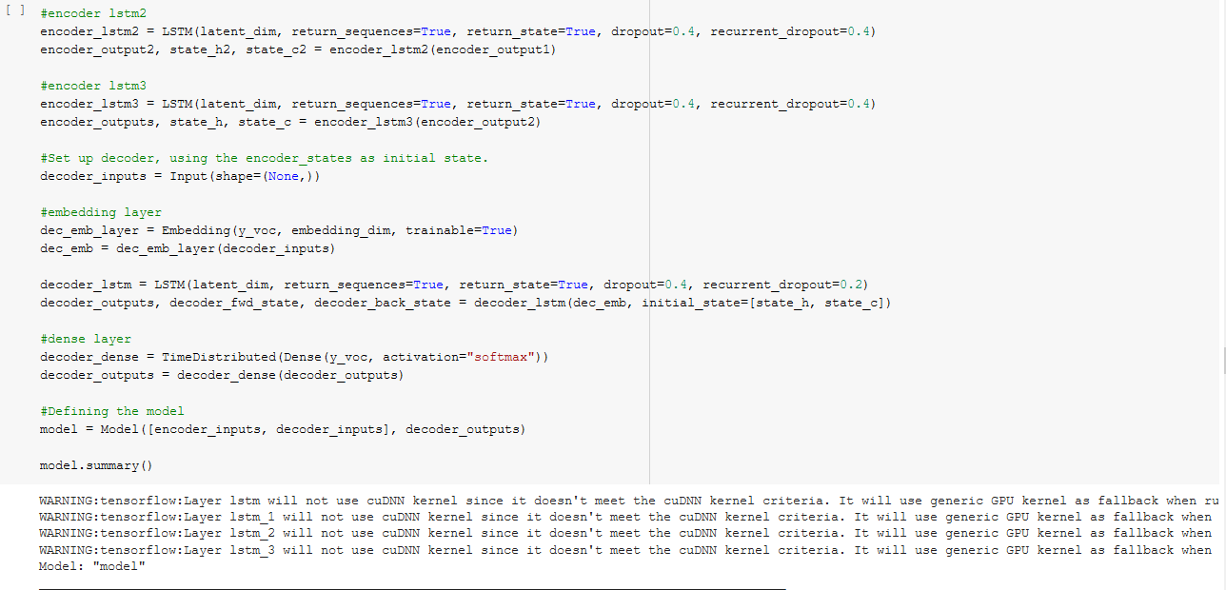
Code Implementation

Slide 35
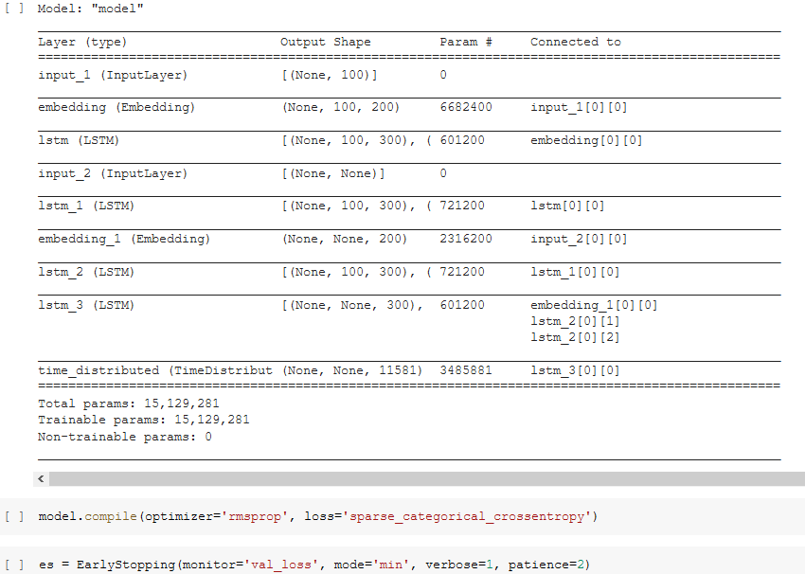
Code Implementation

Slide 36
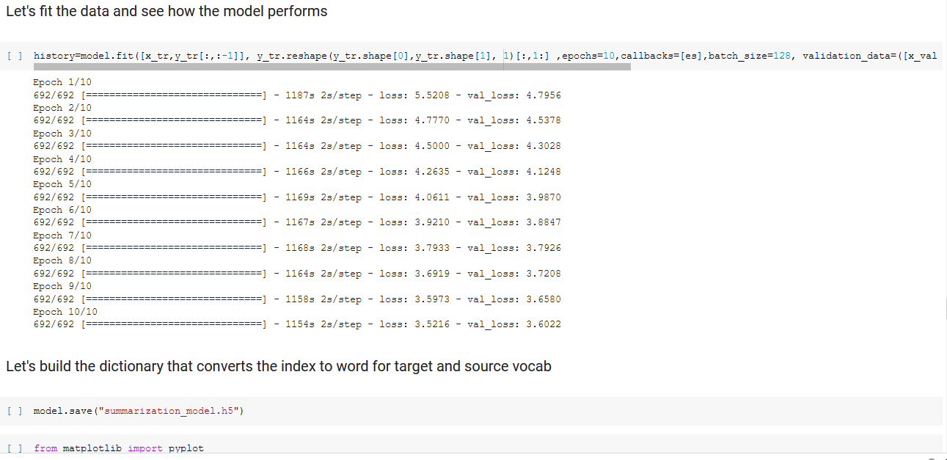
Code Implementation

Slide 37
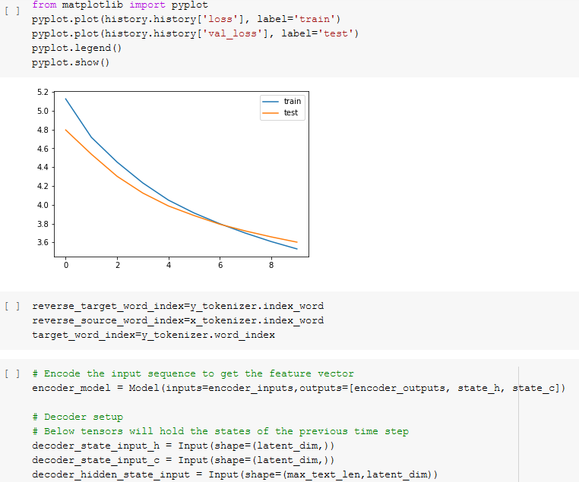
Code Implementation

Slide 38
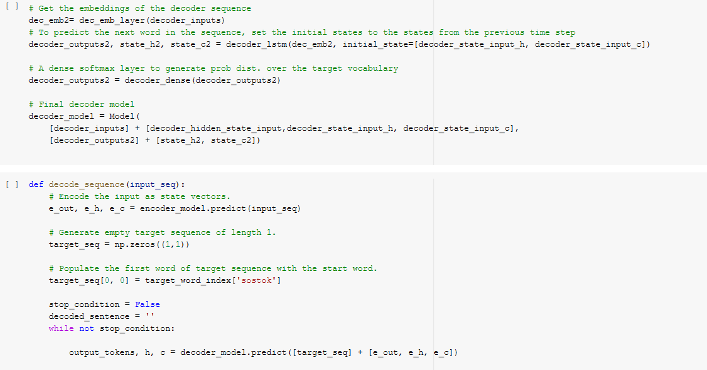
Code Implementation

Slide 39
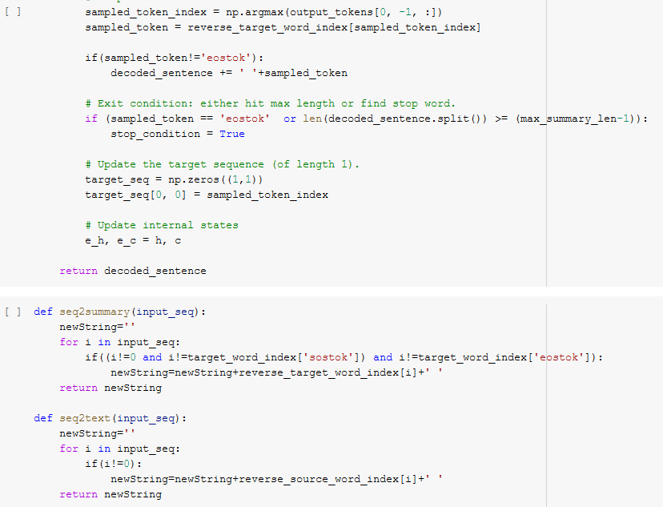
Code Implementation

Slide 40
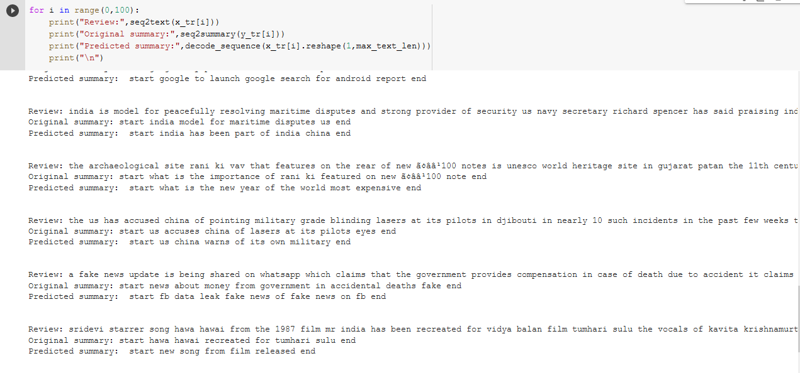
Code Implementation

Slide 41

Thank you!

